Slide 1
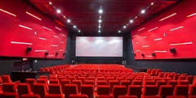
Online Movies Booking System Web Application
Name:Ashish Pokhrel
00172912

Slide 2
Introduction
Online movies Booking System is a web portal where user can easily book ticket for movies through online.
Online movie Booking System is basically made from providing the customers an anytime and anywhere to book seat for cinemas.

Slide 3
Promblem Statement
Many problems encounters during booking for movies at booking counter of respective at theaters where like one you should stand for queues for long time. The current system for movie booking is outdated and difficult to used. You should go for theaters for booking and can’t get ticket or can’t book seats which you feel comfortable during watching movies and you should go for theaters for know which movies is running and timing of movies.

Slide 4
Objectives
The main aim of project is to book seat for movies in the theaters from online by browsing website from anywhere anytime. Other this project is to reduce numbers of staffs in ticket counter and promote movies on the internet. To maintain custom satisfaction and to promote movies in internet. System will provide complete details of movies to the customers.
The main objectives of online movies system are to manages all movies, customer, ticket, Audi, Show time etc. It manages all information related to movies, customer, Audi, price, timing, etc. Its main objective of building this application is to reduce manual work and customer can easily book seats from their home. System will increase profit for organization. Other objective of system is to obtain statics information from booking system. To provide anytime anywhere services to the customers.

Slide 5
Development Methology
I have used waterfall approach for this project. Waterfall model is first approach used in the software development.

Slide 6
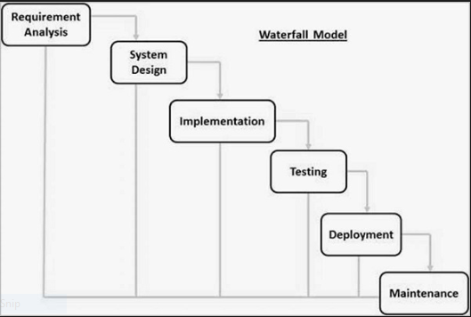
Cont…

